Slide 1
Introduction to Python Session - 3
Sachin Chorge
April 2022

Slide 2

Pandas
Pandas is the most popular library for data analysis.
There are two core objects in pandas: the Dataframe and the Series
To use pandas, you will typically start with the following line of code.

Slide 3
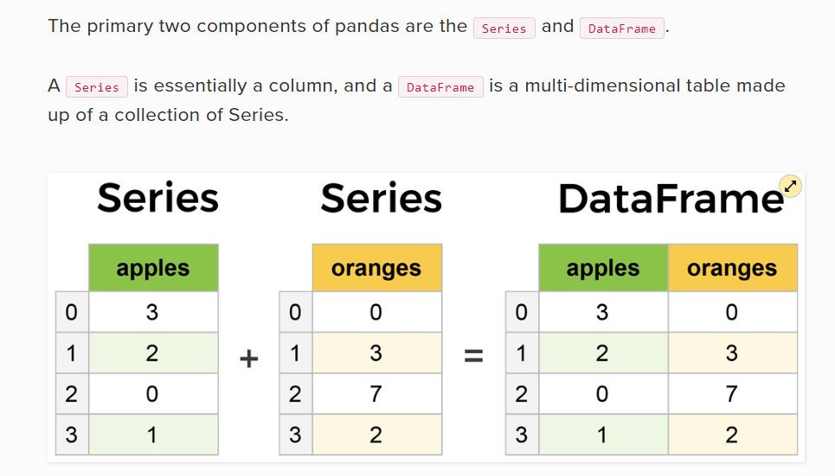
Pandas

Slide 4
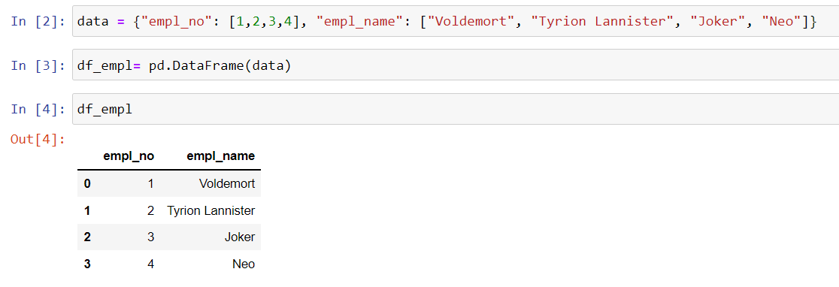
Create dataframe from a dictionary

Slide 5
Create Dataframe from a dictionary

Slide 6
Create Dataframe from a dictionary

Slide 7
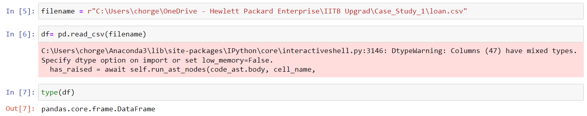
Read Dataframe from a csv file

Slide 8
Learn pandas from user guide
https://pandas.pydata.org/pandas-docs/dev/user_guide/10min.html
Topics to refer from user guide.

Slide 9
Quiz (Using Python code)
a,b = 1,5
which gives a= 1 and b= 5
Write the code to swap the numbers, i.e. a= 5, b= 1.
What is the output of the below code.
Var = “Tiger”*2*3
print(Var)

Slide 10
Quiz (Using Python code)
What is the output of the following code
Var1= 5
Var2= 10
Var3= “7”
Var1 + Var2 + Var3
aList = [4, 8, 12, 16]
aList[1:4] = [20, 24, 28]
print(aList)

Slide 11
Quiz (Using Python code)
Find all of the numbers from 1–1000 that are divisible by 8
string = "Practice Problems to check participants knowledge on python introduction.“
Count the number of spaces in a string
Find all of the words in a string that are more than 6 letters
Use a dictionary comprehension to count the length of each word in above sentence

Slide 12
Quiz (Using Python code)
List1= [1,2,3]
List2= List1
List2.append(4)
Print(List1)
In python List is mutable, True or False?

Slide 13
Quiz (Using Python code)
"welcome to the beautiful world of python“
What is the function to convert the above string to
“Welcome To The Beautiful World Of Python”
What is a diagonal matrix?

